Slide 1
PROTECT YOUR SKIES

Slide 2
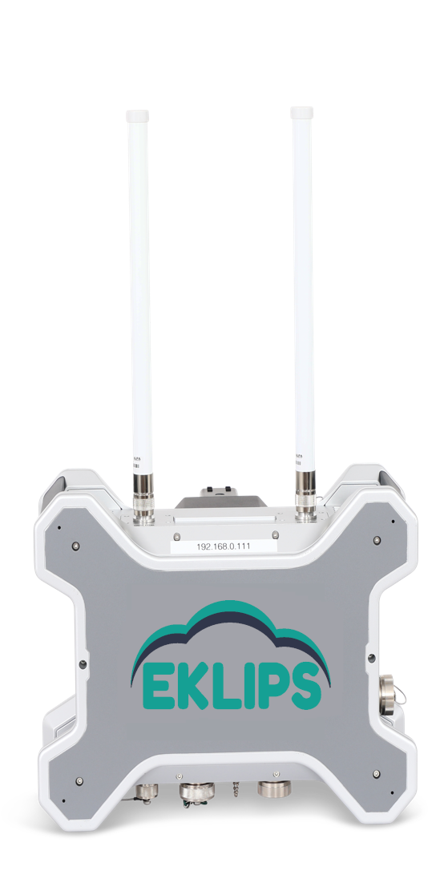
EKLIPS
DETECT & TRACK
IDENTIFY
MITIGATE
Founded in 2002, GR Sistemi is recognized as leader in global security by several governments, banks & manufacturing industries.
We provide solutions in the field of IT, cyber security, electronic surveillance and remote monitoring.
GR Sistemi main activity focuses on leading edge high technology where we specialise in software development and rapid hardware prototyping
Notes:
The commercial drones' market is growing very fast,
Growth ration of more than 35% annually → more than doubling its size every 3 years

Slide 3
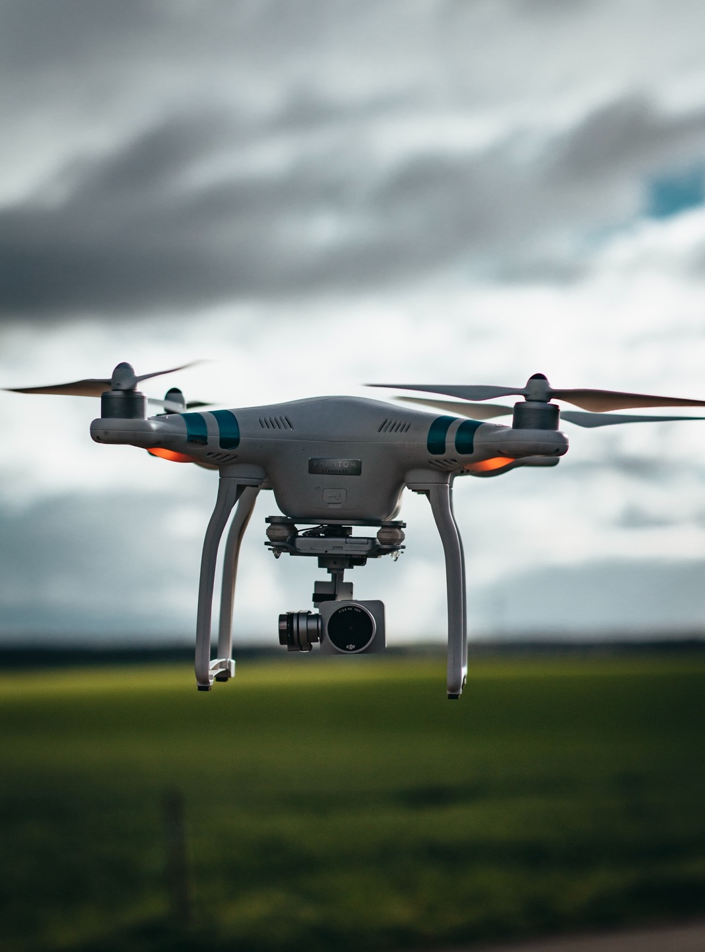
EKLIPS
COMMERICAL DRONES
ARE TAKING OFF
Drone market size and forecast
Revenue, USD bn
Source: Dronelife.com
Notes:
The commercial drones' market is growing very fast,
Growth ration of more than 35% annually → more than doubling its size every 3 years

Slide 4
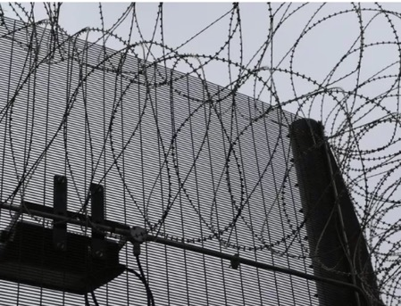
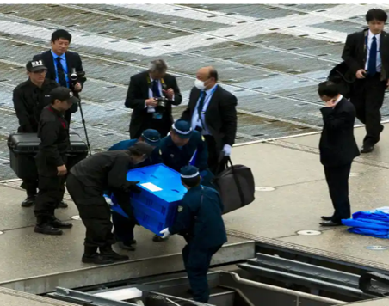
EKLIPS
THE THREAT IS EVERYWHERE
Well-organized gang flew drones carrying drugs into prisons BBC, 30th August 2018
Drone 'Containing radiation' Lands on Roof of Japanese PM's Office The Guardian, April 2015
Aviation - Airports
Correctional Institutes
Landmarks
Stadiums & Entertainment
Critical Infrastructure
Falcons vs. Seahawks Temporarily Delayed
Because of Drone Flying over Lumen Field B/R Sports, 26th September 2022
Drone activity in an oil field
in the Danish North Sea Drone DJ, 30th September 2022, North Sea
Drone Crashing Into
Historical Landmarks Drone DJ, 5th May, 2022, Italy

Slide 5
EKLIPS
NEW SECURITY & SAFETY THREATS APPEAR
Weaponized
Drones
Smuggling of
contrabands
Intelligence
gathering
Mid-air
Collision
Malicious Intentions
Careless operators

Slide 6
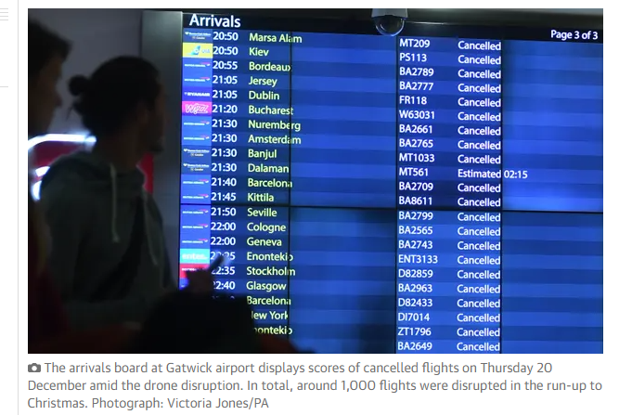
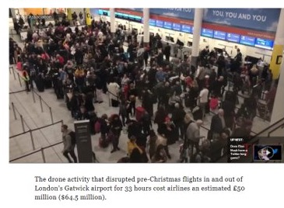
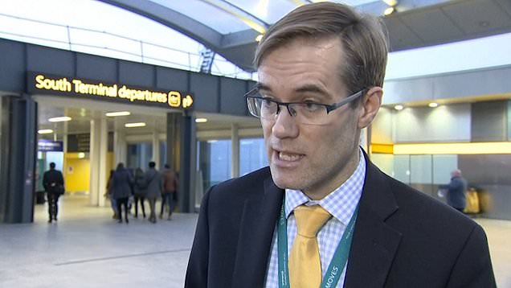
EKLIPS
GATWICK DRONES CLOSURE
NEGATIVE IMPACT ON AIRPORTS' REPUTATION & REVENUE
Over 1,000 flights were disrupted in the runup to Christmas, with 140,000 passengers affected.
Mr. Chris Woodroofe, Gatwick's COO

Slide 7
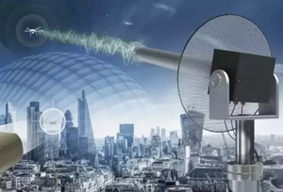
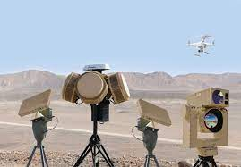
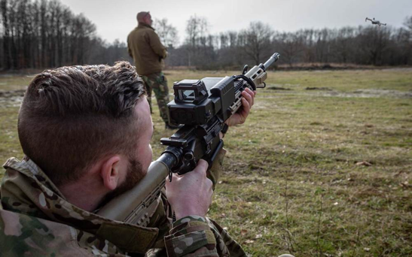
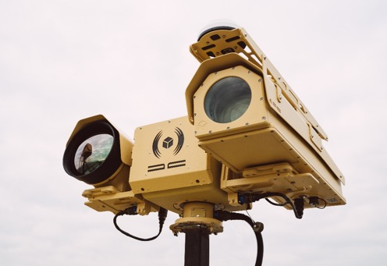
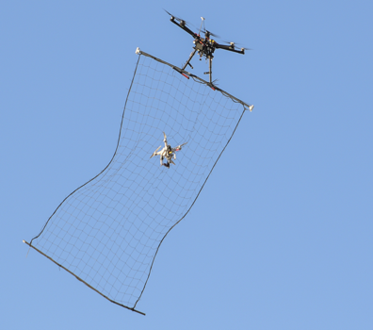
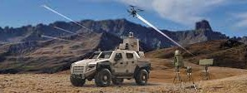
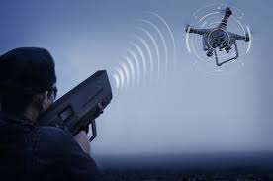
EKLIPS
MANY TYPES OF
COUNTER-DRONE TECHNOLOGIES
Laser / Electro Magnetic
Electro-Optics
Drones Against Drones
Electronic Warfare
Jamming
Kinetic
Spoofing
Kamikaze Drones
Notes:
I think it's super important that we emphasize where the other solutions fall short or at least don't meet airport environments.

Slide 8
PROTECT YOUR SKIES
EKLIPS counter-drone platform.
Designed to automatically detect, identify, track, take over and safely land unauthorized commercial drones in a designated zone.
Notes:
The Eclipse is a “clean” surgical solution with no collateral damage.
Designed to detect, take over and safely land unauthorized commercial drones
The Eclipse is an autonomous end-to-end solution
No Collateral damage and No disruption to the airport operation

Slide 9
MAIN
BENEFITS FOR AIRPORTS
Non-Jamming
No impact on wireless communication and GPS signals
Non-kinetic
Surgical precision with no collateral damage
No false targets
Accurate picture of what is happening.
100% Autonomous
Human real-time decision making is not required.
Friend-Foe
Pinpoints rogue drones
Allows friendly drones to fly freely (Allowed List)

Slide 10
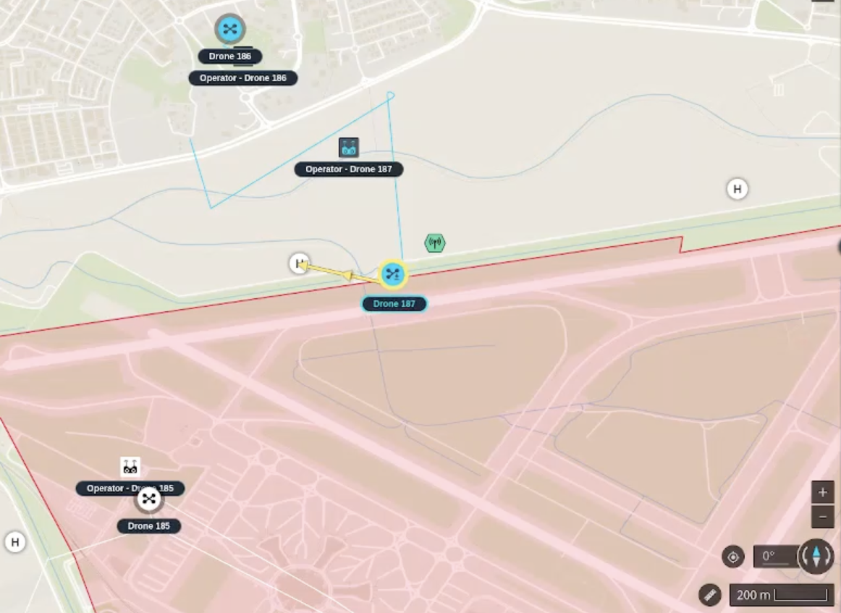
EKLIPS PLATFORM
Placed the Sensor
Define:
- NFZ – Polygon
- Safe Landing area
Add whitelist drones
DETECT & IDENTIFY
24/7 unmanned real-time monitoring
TRACK
Drone type, GPS locations, height & speed Operator Location
X
TAKEOVER
DENY FLY
Automatically take over and safely land in predefined landing zone or home location
Unknown drones won't be able
to fly within the no-fly zone
Notes:
Add demo

Slide 11
EKLIPS
Autonomous Plug & Play Solution
Operates automatically according to pre-defined parameters
Autonomous decision making, no monitoring nor onsite team required
No dedicated trained team
Multi sensors & Multi drones
Native integrated multiple sensors as part of the core system
Multiple drones can be identified and tracked by each sensor
Range & Accuracy
Detect & Track drones – up to 4 km
Take over & safe landing – 1km
Provide the GPS location of the drone and its operator
Meets Highest Standards
Military Grade - IP66 MIL-STD (Water/dust resistance)
CE Certified
Short Development Cycle
S/W Based
No Proprietary H/W
278 mm
Depth: 124.8 mm
372 mm
Notes:
Automation
Autonomous
No 24/7 team required on site
No monitoring
Can send alerts

Slide 12
EKLIPS
THREE DEPLOYMENT TYPES
Stationary
Fixed Installation
Installed on existing site equipment
Portable
Compact kit with tripod stands
Self & fast deployment
Flexible for ad-hoc events
Mounted
Car mounted deployment
Protection on the move
Notes:
Deployment or configuration

Slide 13
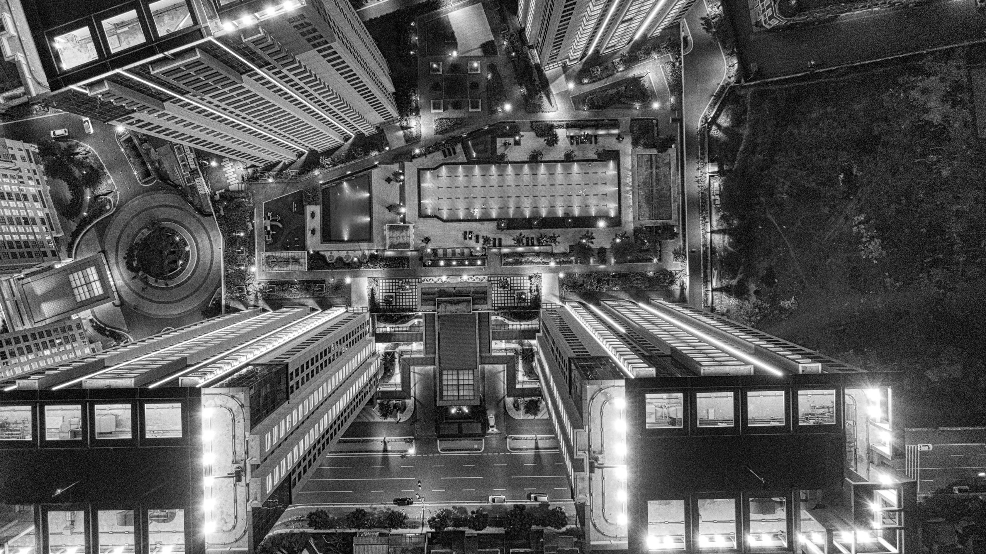
THANK YOU!

